Slide 1
Project Management
CT050-3-3-PRMGT
08: Executing Projects

Slide 2
Topic & Structure of The Lesson
Knowledge area | Executing process | Outputs
Project integration management | Direct and manage project work Manage project knowledge | Deliverables Work performance data Issue log Change requests Project management plan updates Project documents updates Organizational process assets updates Lessons learned register Project management plan updates Organizational process assets updates
Project quality management | Manage quality | Quality report Test and evaluation documents Change requests Project management plan updates Project documents updates
Project resource management | Acquire resources Develop team Manage team | Physical resource assignments Project team assignments Resource calendars Change requests Project management plan updates Project documents updates Enterprise environmental factors updates Organizational process assets updates Team performance assessments Change requests Project management plan updates Project documents updates Enterprise environmental factors updates Organizational process assets updates Change requests Project management plan updates Project documents updates Enterprise environmental factors updates

Slide 3
Topic & Structure of The Lesson
Knowledge area | Executing process | Outputs
Project communications management | Manage communications | Project communications Project management plan updates Project documents updates Organizational process assets updates
Project risk management | Implement risk responses | Change requests Project documents updates
Project procurement management | Conduct procurements | Selected sellers Agreements Change requests Project management plan updates Project documents updates Organizational process assets updates
Project stakeholder management | Manage stakeholder engagement | Change requests Project management plan updates Project documents updates Organizational process assets updates

Slide 4
Learning Outcomes
At the end of this topic, You should be able to
List the processes and outputs of project execution
Discuss what is involved in directing and managing project work and project knowledge.
Explain the importance of creating documents in quality assurance.
Describe the executing processes.
Discuss important communications concepts.
Describe the process of managing stakeholder engagement.
Understand the process of implementing risk responses.
Explain the process of conducting procurements.

Slide 5
Key Terms You Must Be Able To Use
If you have mastered this topic, you should be able to use the following terms correctly in your assignments and exams:
project documents updates
final products, services, or result transition
a final report
updates to organizational process assets

Slide 6
Introduction
Project execution is the most noticed process group.
Majority of a project’s time and budget is spent on project execution.
Many of the deliverables and outputs created in the other process groups are fairly similar from project to project, but no two projects are ever executed in the exact same way due to uncertainties and unique challenges

Slide 7
Project Integration Management
To direct and manage project stakeholders, project managers can follow several important practices:
Coordinate planning and execution.
Develop and use soft skills.
Provide a supportive organizational culture.
Break the rules when needed.
Capitalize on product, business, and application area knowledge.
Use project execution tools and techniques.
Main outputs during execution are:
Deliverables,
work performance data,
Issue logs,
Change requests,
Project management plan updates,
Project documents updates,
Organizational process assets updates

Slide 8
Work Performance Data
A common way to summarize work performance information is by using a milestone report.
Recall that a milestone is a significant event on a project, such as completing a major deliverable or awarding a major contract.
In addition to listing the milestones, the report lists the planned date for completion (in month/day format), the status, the person responsible for the milestone, and issues/comments

Slide 9
Sample Milestone Report for Reporting Work Performance Data
Milestone | Date | Status | Responsible | Issues/Comments
Researched existing training | 8/13 | Complete | Jamie (replaced by Abner) | Many basic courses available, but not much advanced/tailored training. ( Note: Replaced Jamie with better candidate for project after Jamie completed this task)
Presented supplier management training survey results to steering committee | 8/24 | Complete | Kristin | Great feedback. Many people stressed the need to have instructor-led training and mentors for soft skills development
Meetings with potential partners | 9/21 | In progress | Kristin/ Contracting | May need more time for meetings

Slide 10
Issue Logs
An issue log helps to document, monitor, and track issues that need to be resolved for effective work to take place.
An issue is a matter under question or dispute that could impede project success.
A critical issue is anything that prevents progress on scheduled activities.
If the activity is on the critical path, resolution is urgent. There should be an issue escalation process that ensures issue resolution action.

Slide 11
Sample Issue Log
Issue # | Issue Description | Impact on Project | Date Reported | Reported By | Assigned To | Priority (H/M/L) | Due Date | Status | Comments/ Follow-up
1 | Key project team member is not working out | Can severely hurt project because Jamie is our supplier management expert | Aug 2 | Kristin | Kristin | H | Sep 2 | Open | Working with Jamie and appropriate managers to find a replacement
2 | IT staff that is performing survey is over allocated | Delaying the survey will delay the entire project because it is a critical task | Sep 26 | Mohamed | Kristin | H | Aug 5 | Closed | Paid overtime was approved
Etc.

Slide 12
Change Requests
Number of requests for changes emerge during project execution.
Recall that a process for handling changes should be defined during project planning as part of the project management plan.
It is important during project execution to formally and informally request appropriate changes.

Slide 13
Sample Change Request (partial)
Project Name: Just-In-Time Training Project
Date Request Submitted: September 22
Title of Change Request: Provide overtime to get survey results in time
Change Order Number: A200-17
Submitted by: Kristin Maur
Change Category:__Scope __Schedule _X_ Cost __Technology __Other
Description of change requested:
In order to avoid a schedule slip and have appropriate internal resources available, we are requesting the approval of paid overtime for creating and distributing the survey for the supplier management course.
Events that made this change necessary or desirable:
The IT person assigned to our project has several other important projects on-hand. If these tasks are delayed, the entire project will be delayed.
Justification for the change/why it is needed/desired to continue/complete the project:
We must send out and analyze the survey in a timely manner since we need the information to develop the first supplier management course and select an appropriate supplier.
Impact of the proposed change on:
Scope: None Schedule: None Cost: $550
Staffing: One IT person will work 10 hours of paid overtime basis over a period of several weeks.
Risk: Low. This person suggested the paid overtime and has successfully worked overtime in the past.
Other: None
Suggested implementation if the change request is approved: Include the overtime pay in the normal paycheck.

Slide 14
Managing Project Knowledge
New process, main output is a lessons learned register
Two types of knowledge:
Explicit knowledge: This type of knowledge can be easily explained using words, pictures, or numbers and is easy to communicate, store, and distribute. Examples include information found in text books and encyclopedias as well as project documents and plans.
Tacit knowledge: Unlike explicit knowledge, tacit knowledge, sometimes called informal knowledge, is difficult to express and is highly personal. Examples include beliefs, insight, and experience. It is often shared through conversations and interactions between people. Many organizations set up programs like mentorships, communities of practice, or workshops to assist in passing on tacit knowledge.

Slide 15
Sample Lessons Learned Register
ID | Date identified | Owner | Name | Category | Situation | Recommendation
01 | 9/22 | Kristin | Overtime | Cost | IT person was overbooked. Decided to pay overtime to finish survey work in time and not delay project end date. | Don’t be afraid to suggest paid overtime, even though it’s not used often at our organization.
02 | 10/1 | Kim | Curriculum blog | Tech-nology | Kim was having trouble getting inputs on specific requirements for curriculum, so she set up a blog and provided incentives for inputs. | Encourage people to be creative. Allow use of some of the budget for incentives related to producing that deliverable.

Slide 16
Managing Quality
Quality assurance includes all the activities related to satisfying the relevant quality standards for a project.
Another goal of quality assurance is continual quality improvement.
Key outputs of managing quality include:
Quality report,
Test and evaluation documents,
Change requests,
Project management plan updates,
Project documents updates.

Slide 17
Quality Improvement Tools and Techniques
Benchmarking generates ideas for quality improvements by comparing specific project practices or product characteristics to those of other projects or products within or outside of the organization itself.
A quality audit is a structured review of specific quality management activities that helps identify lessons learned, which could improve performance on current or future projects.
Process analysis involves analyzing how a process operates and determining improvements.

Slide 18
Project Resource Management
Effective use of resources is crucial to project execution. The main processes project managers perform include acquiring resources, developing the team, and managing the team.
Key outputs:
Physical resource assignments,
Project team assignments,
Resource calendars,
Team performance assessment,
Change requests, and updates to the project management plan,
Enterprise environmental factors, and organizational process assets.

Slide 19
Motivation
Project managers must understand motivation theories to effectively execute projects.
Psychologists, managers, coworkers, teachers, parents, and most people in general still struggle to understand what motivates people, or why they do what they do.
Intrinsic motivation causes people to participate in an activity for their own enjoyment.
Extrinsic motivation causes people to do something for a reward or to avoid a penalty.
Maslow suggested that people’s behaviors are guided or motivated by a sequence of needs.

Slide 20
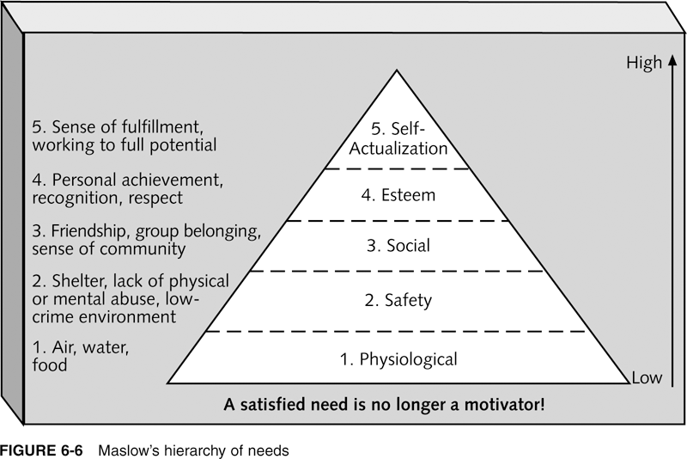
Maslow’s Hierarchy of Needs
Schwalbe, Information Technology Project Management, Sixth Edition, 2010

Slide 21
Herzberg’s Motivational and Hygiene Factors
Frederick Herzberg wrote several famous books and articles about worker motivation. He distinguished between the following:
Motivational factors: Factors that cause job satisfaction, such as achievement, recognition, the work itself, responsibility, advancement, and growth
Hygiene factors: Factors that cause dissatisfaction if not present, but do not motivate workers to do more. Examples include larger salaries, more supervision, and a more attractive work environment

Slide 22
McClelland’s Acquired-Needs Theory
Specific needs are acquired or learned over time and shaped by life experiences, including:
Achievement (nAch): People with a high need for achievement like challenging projects with achievable goals and lots of feedback
Affiliation (nAff): People with high nAff desire harmonious relationships and need to feel accepted by others, so managers should try to create a cooperative work environment for them
Power: (nPow): People with a need for power desire either personal power (not good) or institutional power (good for the organization). Managers should provide institutional power seekers with management opportunities

Slide 23
McGregor’s Theory X and Y
Douglas McGregor popularized the human relations approach to management in the 1960s
Theory X: Assumes workers dislike and avoid work, so managers must use coercion, threats and various control schemes to get workers to meet objectives
Theory Y: Assumes individuals consider work as natural as play or rest and enjoy the satisfaction of esteem and self-actualization needs

Slide 24
Thamhain and Wilemon’s Ways to Have Influence on Projects
1. Authority: The legitimate hierarchical right to issue orders.
2. Assignment: The project manager's perceived ability to influence a worker's later work assignments.
3. Budget: The project manager's perceived ability to authorize others' use of discretionary funds.
4. Promotion: The ability to improve a worker's position.
5. Money: The ability to increase a worker's pay and benefits.
6. Penalty: The project manager's ability to cause punishment.
7. Work challenge: The ability to assign work that capitalizes on a worker's enjoyment of doing a particular task.
8. Expertise: The project manager's perceived special knowledge that others deem important.
9. Friendship: The ability to establish friendly personal relationships between the project manager and others.

Slide 25
Acquiring Resources
Project resources include both physical and human resources
Physical resources include equipment, supplies, and materials
Human resources include the people required to perform the project work
After developing a staffing management plan during project planning, project managers must work with other managers in their organizations to assign personnel to their project or to acquire additional human resources needed to staff their project

Slide 26
Resource Loading
Resource loading refers to the amount of individual resources an existing schedule requires during specific time periods.
Helps project managers develop a general understanding of the demands a project will make on the organization’s resources and individual people’s schedules.
Overallocation means more resources than are available are assigned to perform work at a given time.

Slide 27
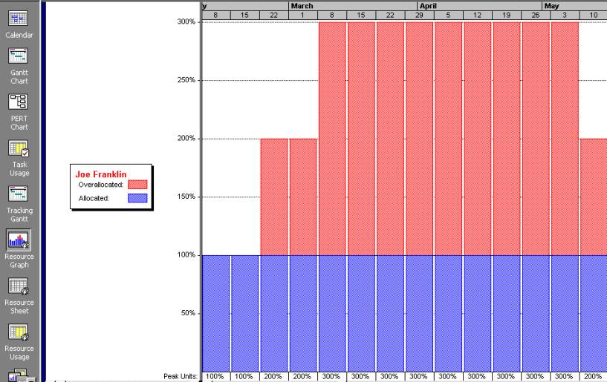
Sample Resource Histogram Showing an Overallocated Individual

Slide 28
Resource Leveling
Resource leveling is a technique for resolving resource conflicts by delaying tasks.
The main purpose of resource leveling is to create a smoother distribution of resource usage and reduce overallocation

Slide 29
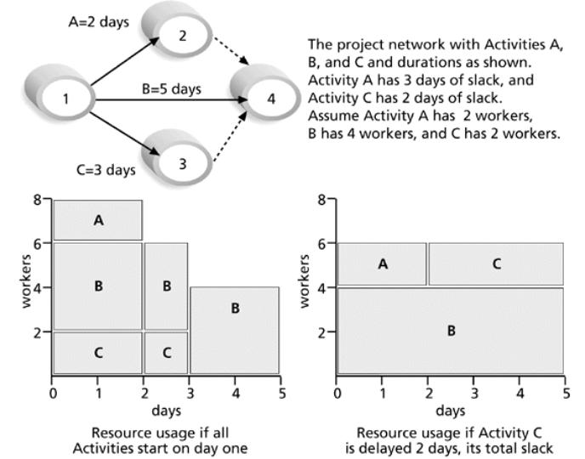
Resource Leveling Example

Slide 30
Developing the Project Team
Many failed projects have been staffed by highly talented individuals; however, it takes teamwork to complete projects successfully.
The main goals of team development are to help people work together more effectively, improve interpersonal skills, increase motivation, reduce attrition, and improve overall project performance.
Project managers should understand and apply good team-building practices because it takes teamwork to successfully execute most projects

Slide 31
Tuckman Model of Team Development
Forming
Storming
Norming
Performing
Adjourning

Slide 32
Training
Project managers often recommend that people take specific training courses to improve individual and team development.
Team-building activities include using physical challenges and psychological preference indicator tools, such as the Meyers-Briggs Type Indicator and the Wilson Learning Social Styles Profile.

Slide 33
Managing the Project Team
Project managers must use their soft skills to find the best way to motivate and manage each team member.
Tools and techniques include:
Observation and conversation
Feedback
Conflict management

Slide 34
Project Communications Management
Good communications management is crucial to project execution.
The process of managing communications involves gathering information to create, distribute, store, retrieve, and dispose of project communications in accordance with the communications management plan
Disposal does not mean discarding. It means putting documents in a defined place, and document retention regulations may determine document disposal policies.
The main outputs:
project communications and updates to project documents,
project management plan,
organizational process assets

Slide 35
Important Project Communications Concepts
It is important to address important concepts related to improving project communications.
Key concepts include:
Formal and informal communications
Nonverbal communications
Using the appropriate communications medium
Understanding individual and group communication needs
The impact of team size on project communications

Slide 36
Formal and Informal Communications
It is not enough for project team members to submit formal status reports to their project managers and other stakeholders and assume that everyone who needs to know that information will read the reports.
In fact, many people may prefer to have an informal, two-way conversation about project information.
Project managers must be good at nurturing relationships through good communication

Slide 37
The Impact of Team Size on Project Communications
As the number of people involved increases, the complexity of communications increases because there are more communications channels, or pathways, through which people can communicate
Number of communications channels = n(n-1)
2 where n is the number of people involved
For example, two people have one communications channel: (2(2–1))/2 = 1. Five people have ten channels (5(5-1))/2=10
It is often helpful to form several smaller teams within a large project team to help improve project communications

Slide 38
Project Stakeholder Management
The process of managing stakeholder engagement involves:
Working with various project stakeholders to meet their needs and expectations,
Addressing stakeholder issues as they occur,
Fostering engagement in project decisions and activities.
The key benefit of managing stakeholder engagement, if done well, is that it allows the project manager to increase support and minimize resistance from stakeholders, significantly increasing the chances to achieve project success

Slide 39
Managing Stakeholder Engagement
Good teachers use several techniques to engage students; project managers also need to actively engage project stakeholders.
Need to set the stage early so stakeholder engagement is expected and welcomed.
Many of the outputs are similar to other knowledge areas, such as change requests and updates to the project management plan and project documents

Slide 40
Project Risk Management
The main executing task performed as part of project risk management is implementing risk responses as defined in the process to plan risk responses.
Key outputs include:
Change requests,
Project documents updates (i.e., issue log, lessons learned register, project team assignments, risk register, and risk report)

Slide 41
Project Procurement Management
The main executing process is conducting procurements, which involves:
obtaining seller responses to requests for proposals or bids,
selecting sellers,
making agreements.
Prospective sellers do most of the work in this process by preparing their proposals and bids, normally at no cost to the buyer.
The buying organization is responsible for deciding how to approach sellers and providing required procurement documents.
Important documents created as a result of conducting procurements include contracts.

Slide 42
Methods to Approach and Select Qualified Sellers or Suppliers
Approaching a preferred supplier
Approaching several qualified suppliers
Advertising to many potential suppliers

Slide 43
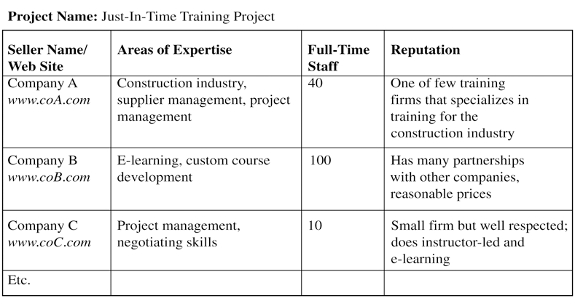
Sample Qualified Sellers List

Slide 44
Selecting Sellers and Writing Contracts
Selecting sellers, often called source selection, involves evaluating proposals or bids from sellers, choosing the best one, negotiating the contract, and awarding the contract.
Often, buyers develop a short list of the top three to five suppliers to reduce the work involved in selecting a source, and they are often asked to prepare a best and final offer (BAFO).
It is good practice to include a detailed statement of work and schedule as part of the contract to clarify exactly what work the seller will perform and when

Slide 45
Sample Agreement or Contract

Slide 46
Quick Review Question

Slide 47
Summary of Main Teaching Points
Good execution is crucial to project success. Without it, the products, services, and results planned from the project cannot materialize.
Common outputs to these knowledge areas include change requests and updates to the project management plan, project documents, and organizational process assets. Unique ones are listed below.
Integration management: deliverables, work performance data, issue log, and lessons learned register
Quality management: Quality report, test and evaluation
Resource management: Physical resource assignments, project team assignments, resource calendars, and team performance assessments
Communications management: Project communications
Procurement management: selected sellers and agreement
Samples of several outputs are provided for the Just-In-Time Training project.

Slide 48
Question and Answer Session
Q & A

Slide 49
What we will cover next
Assignment Clinic
Revision

Slide 50
What we will cover next
09 Monitoring & Controlling Projects

